Slide 1
Statistical Arbitrage
Implementation of Statistical Arbitrage in the U.S. Equities Market by Avellaneda and Lee¹
Presentation by Caleb Suhy
[1] Statistical Arbitrage in the U.S. Equities Market: Avellaneda, Marco and Lee, Jeong-Hyun, Statistical Arbitrage in the U.S. Equities Market (July 11, 2008). Available at SSRN: https://ssrn.com/abstract=1153505 or http://dx.doi.org/10.2139/ssrn.1153505

Slide 2
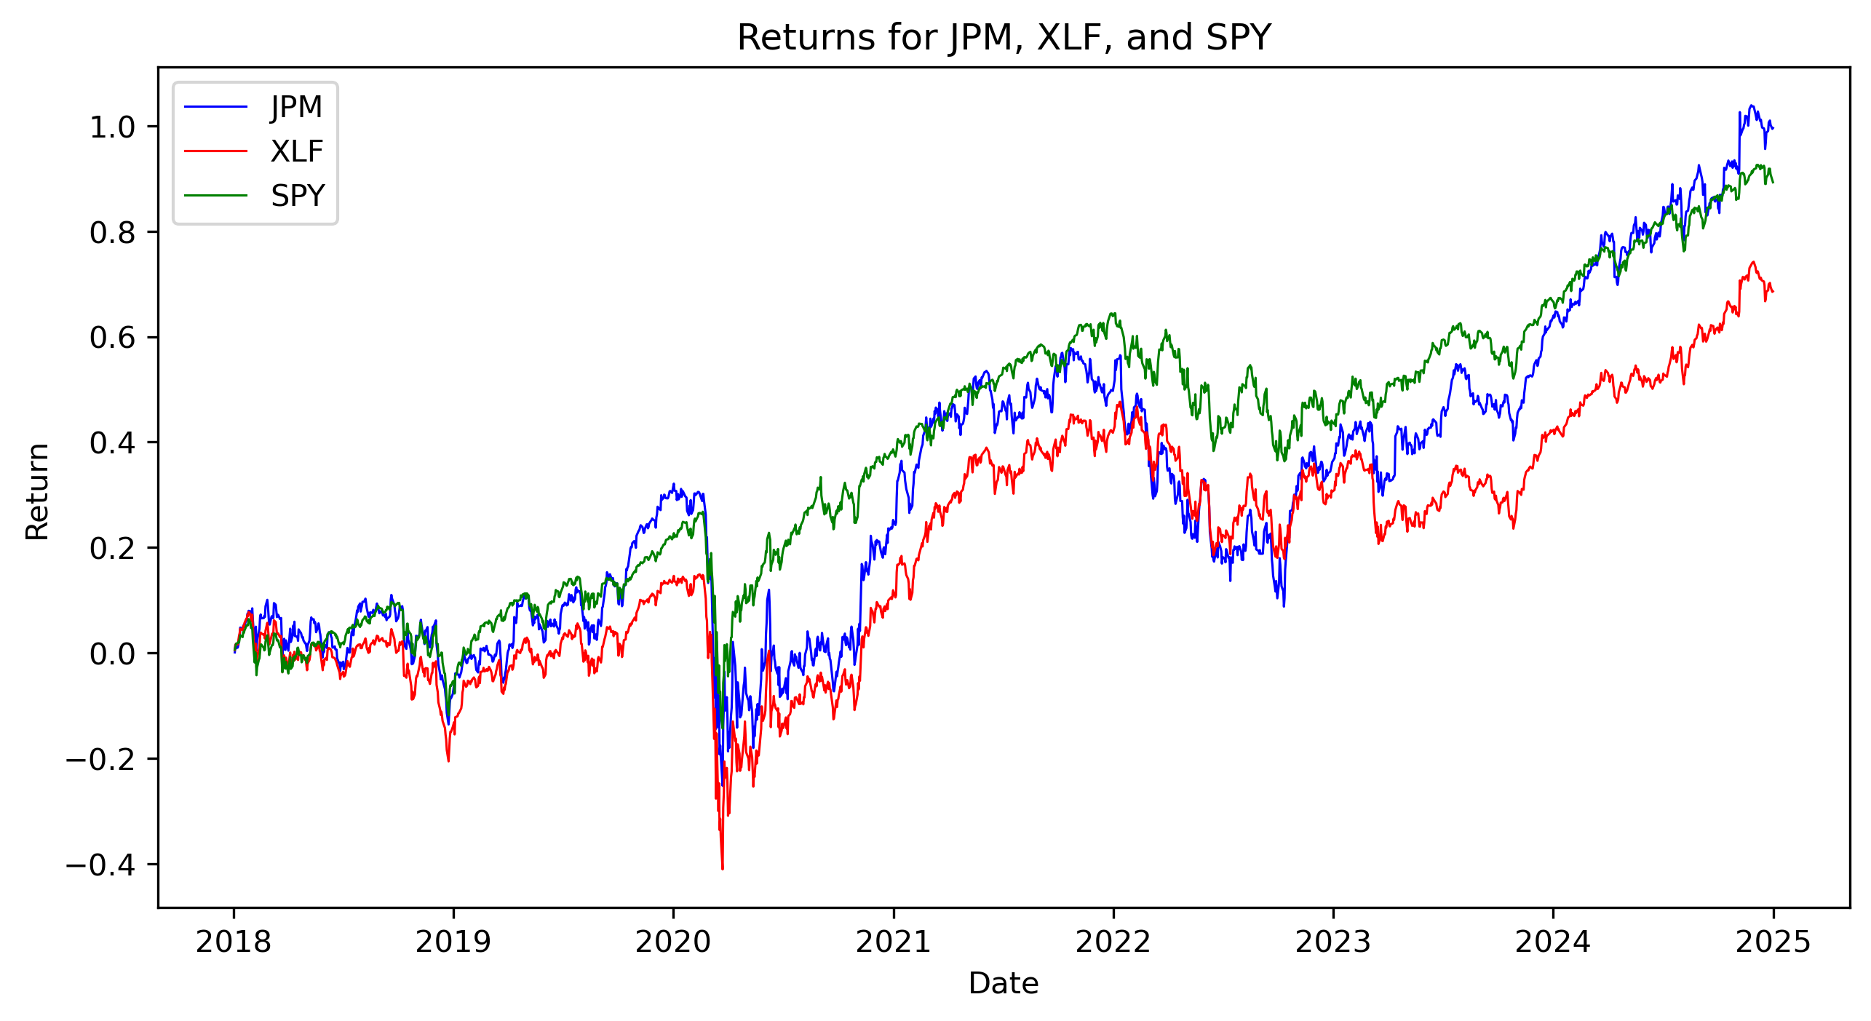
StatArb Basics
→ JPM is the stock we assume will obey the mean reversion principle
→ XLF is the ETF for the financial sector
SPY is an ETF that tracks the S&P500 (tracks the general market)
Economic Factor Model: JPM = 1.37XLF – 0.38SPY

Slide 3
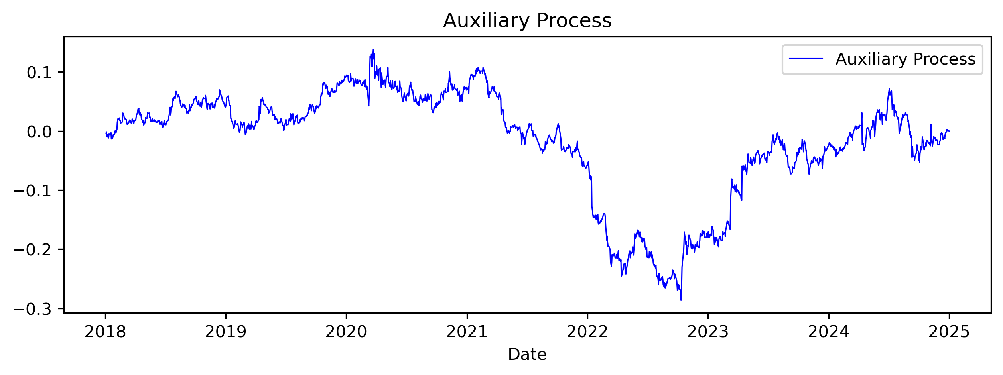
Auxiliary Process
Define the Auxiliary Process as the cumulative sum of the EFM residuals
The central idea underpinning this entire model is that the auxiliary process can be modeled using an Ornstein-Uhlenbeck (OU) process

Slide 4
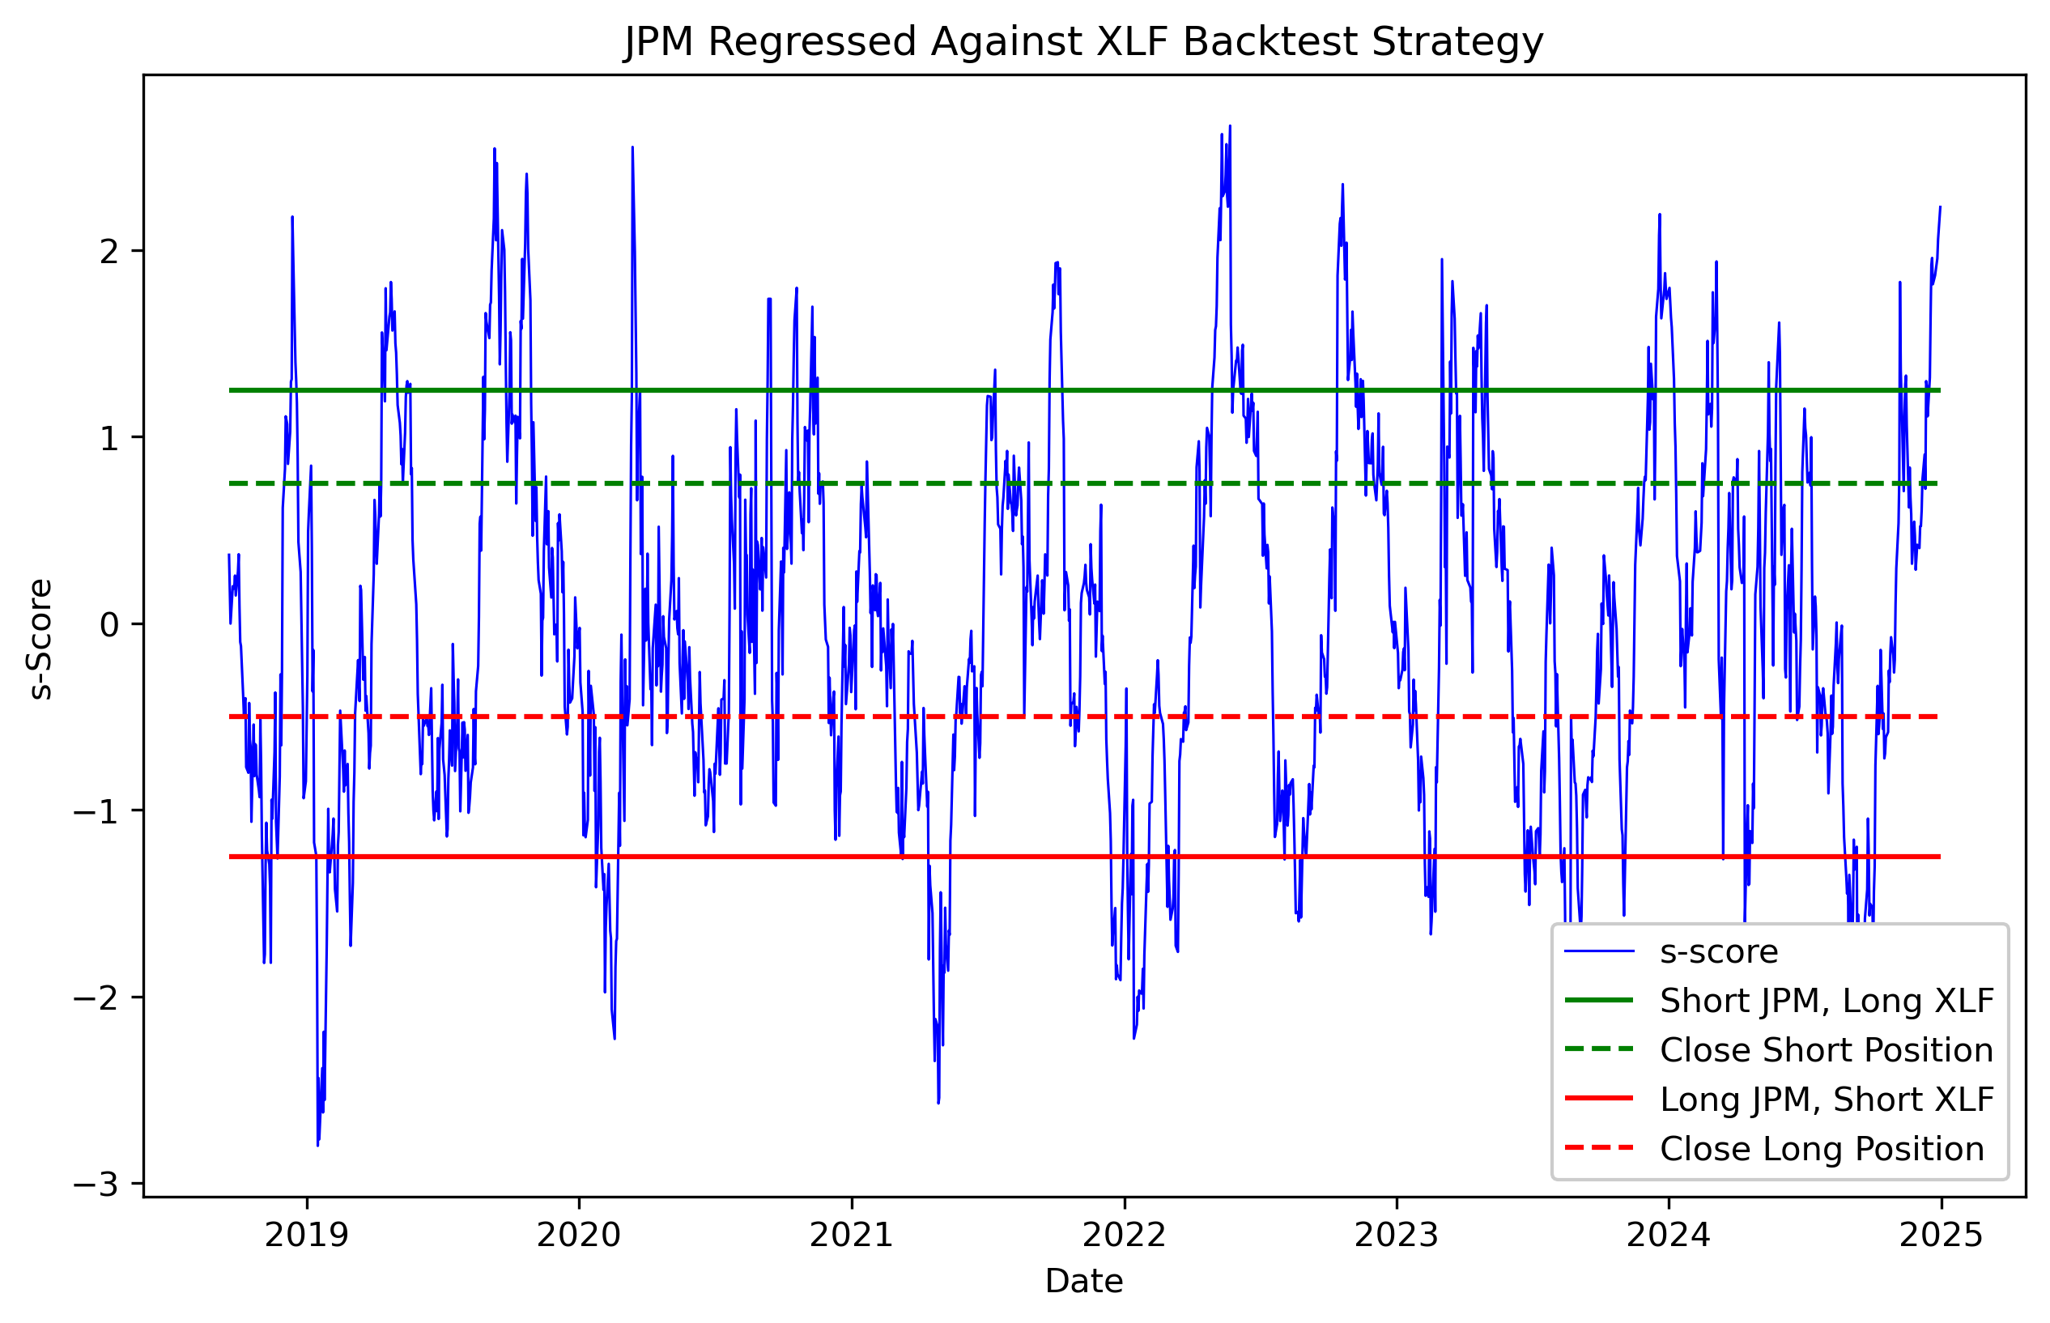
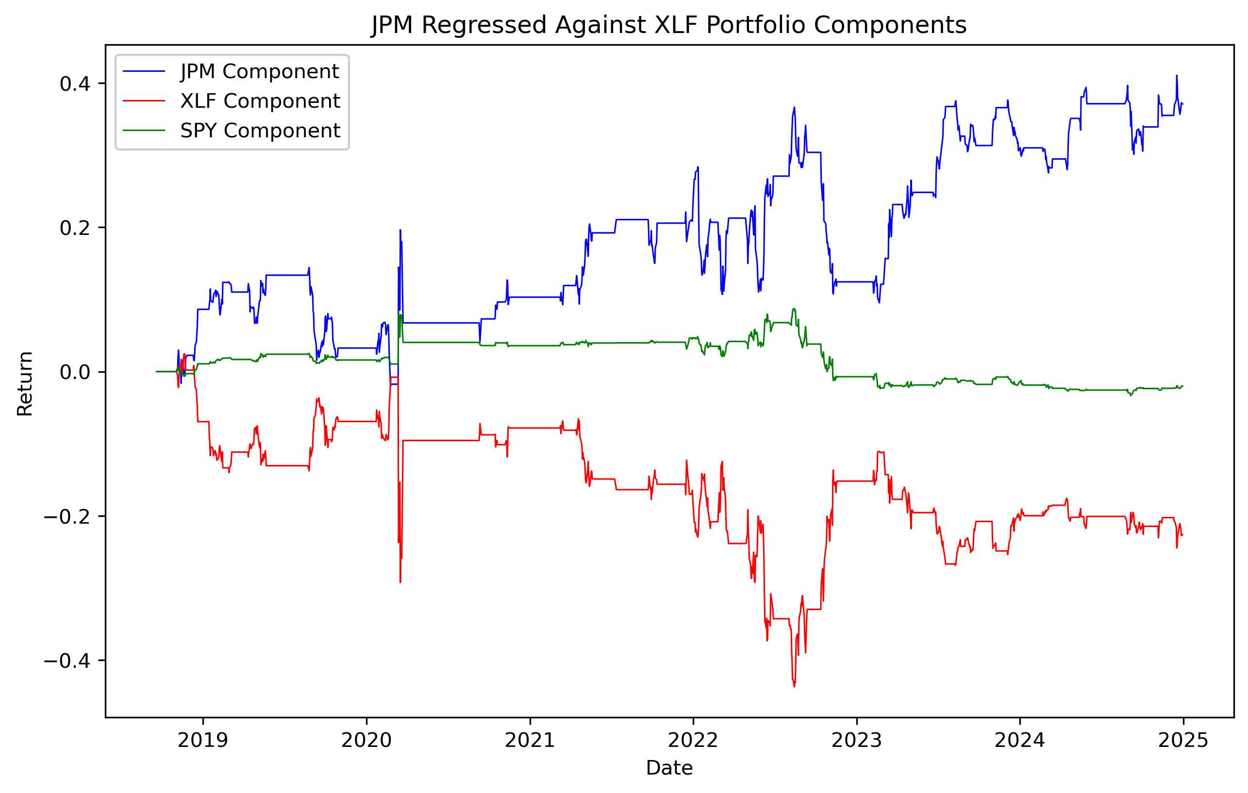
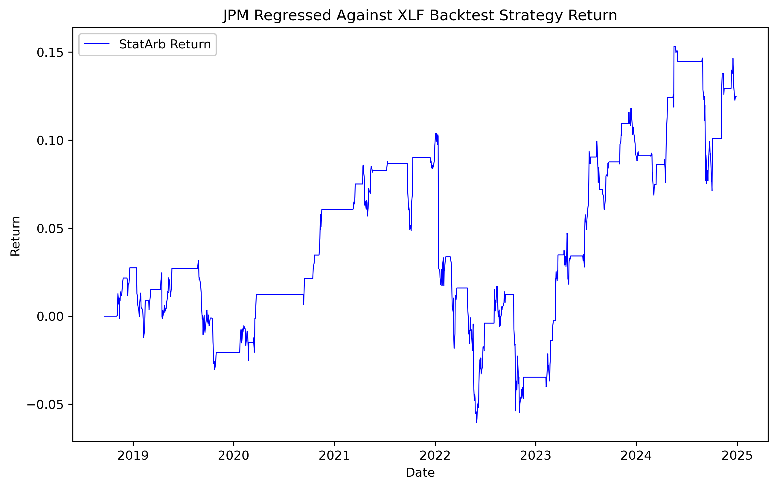
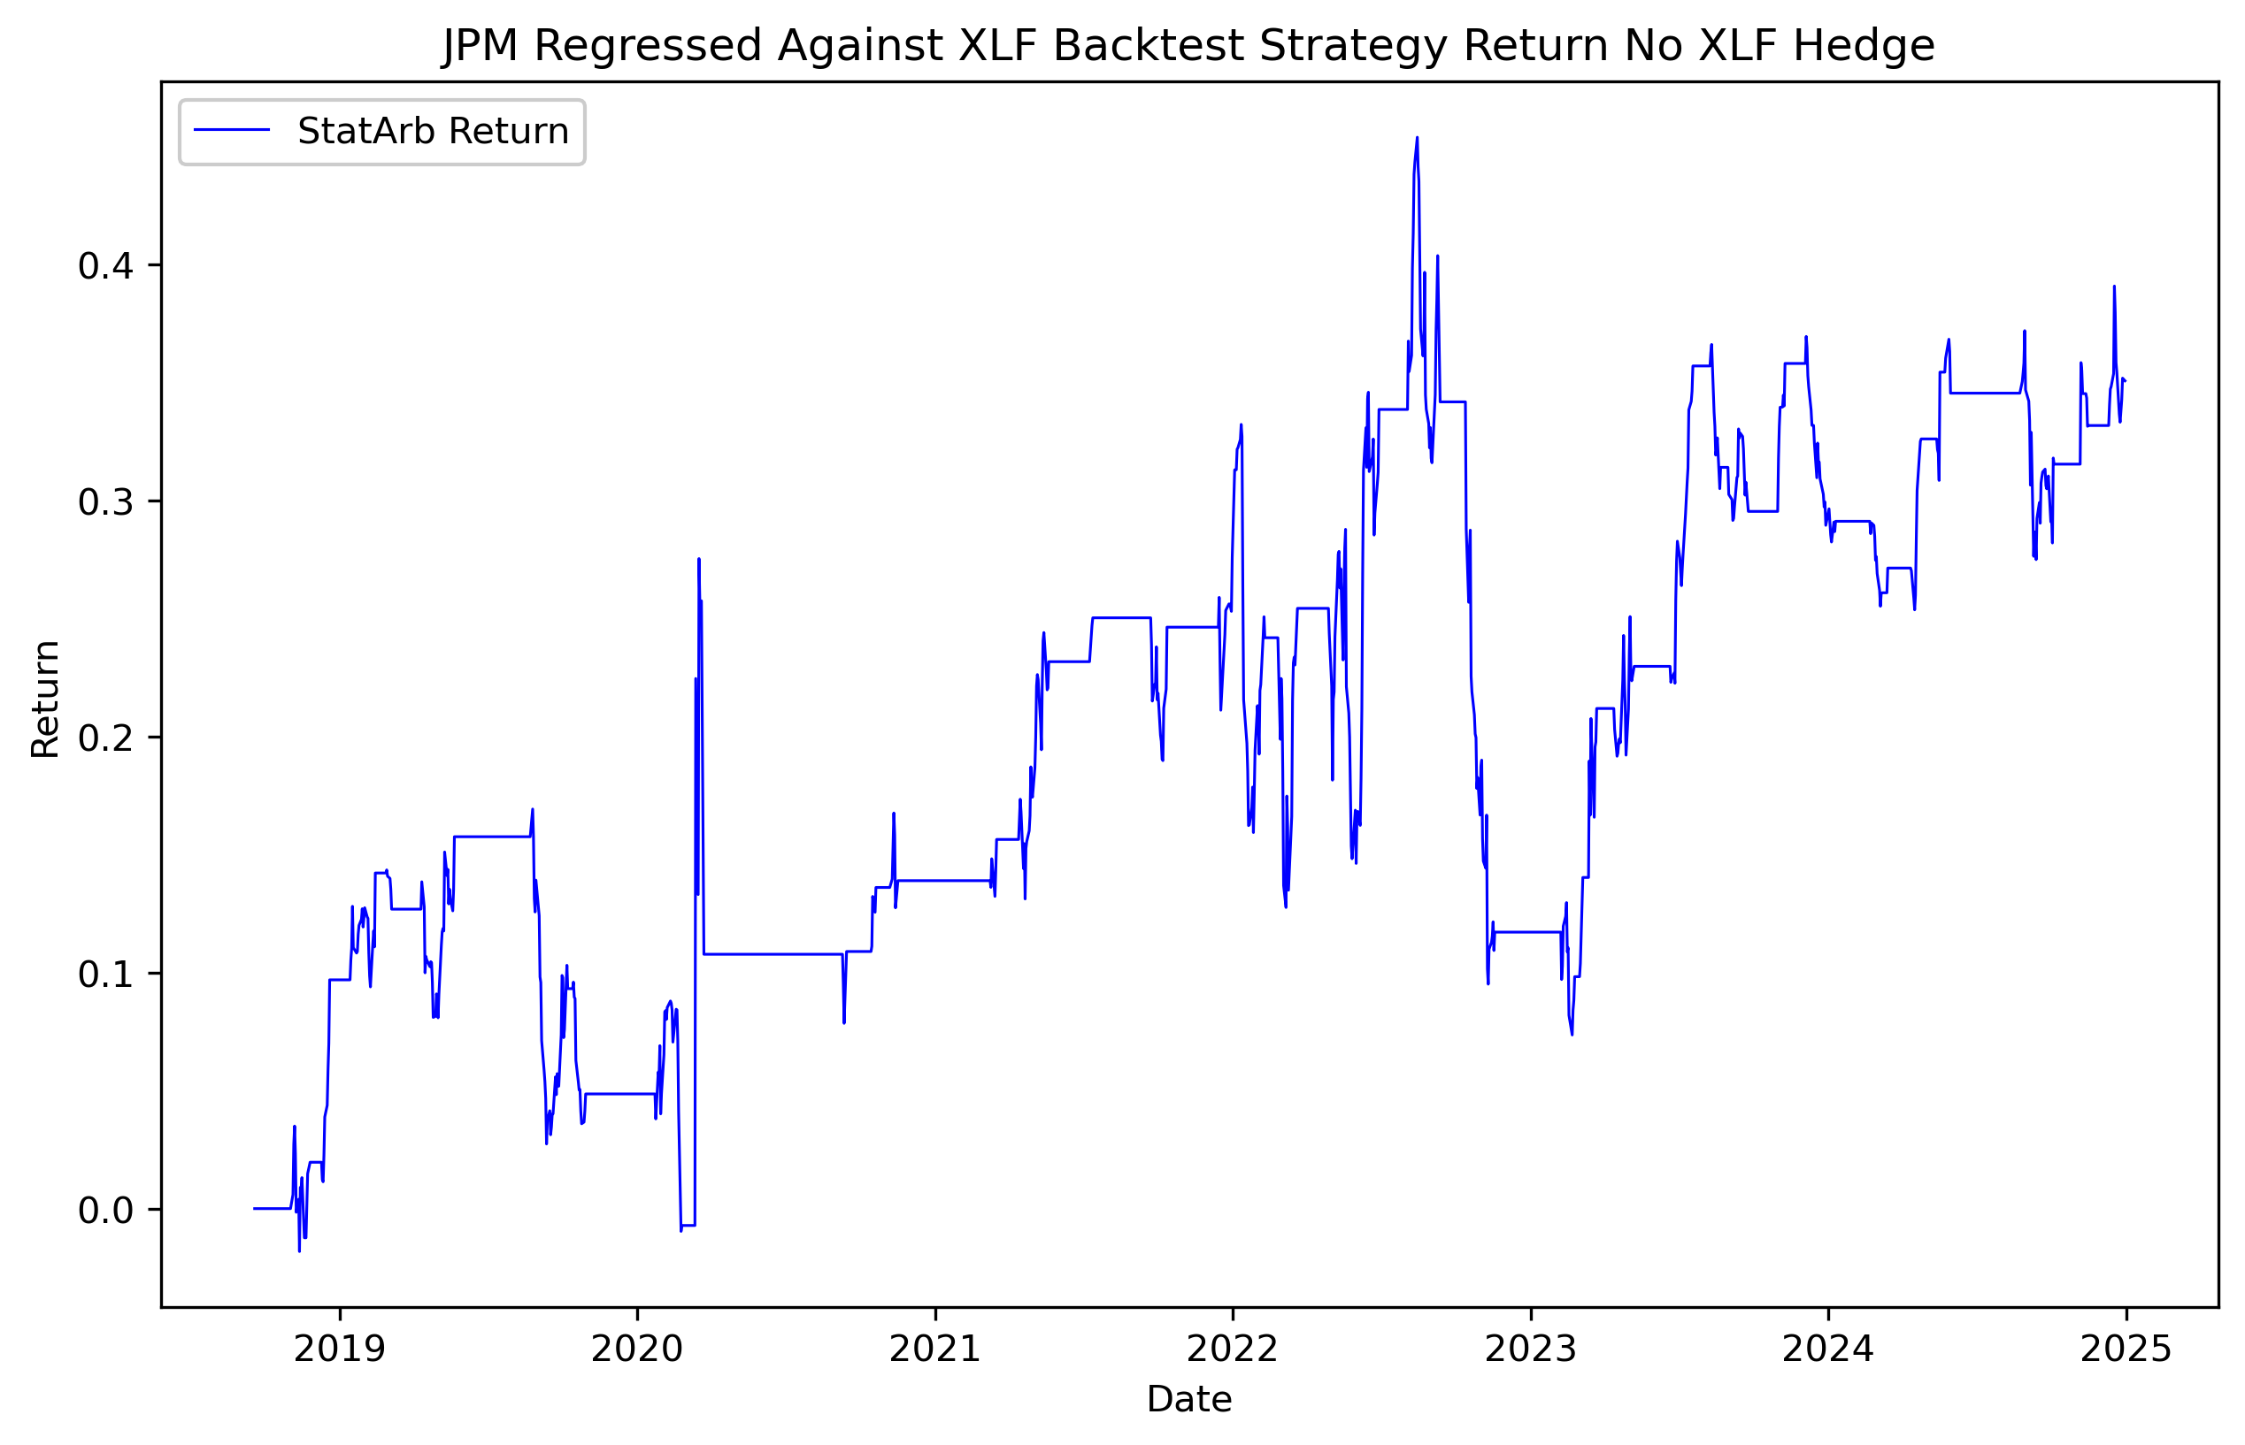
XLF hedge bad?
12.46% cumulative return!
35.08% cumulative return! But there’s a catch…
Sharpe Ratio: 0.29
Max Drawdown: 0.19
Sharpe Ratio: 0.27
Max Drawdown: 0.33

